Slide 1
Human-Centered Design
CSCI 497T/597T

Slide 2
Today’s Topics
Human-centered design
Spiral process
Early focus on users and tasks
User analysis
Task analysis
Data gathering methods
Empirical measurements

Slide 3
What is Human-Centered Design?
Development driven by real users and their goals, not just technology.
Makes the most of human skill
Directly relevant to the work in hand
Supports the user, doesn’t constrain
Gould and Lewis principles for a “useful and easy to use computer system”
Early focus on users and tasks
Empirical measurement
Iterative design
Notes:
Early focus on users and tasks understanding the users, observing them and involving them in the design process.
Empirical measurement Let users interact with simulation and prototypes and observing recording the analyzing their performance and reactions.
Iterative design Repetitive cycles of design, test, measure and redesign.

Slide 4
What is Human-Centered Design (HCD)?
HCD is a design and management framework that develops solutions to problems by involving the human perspective in all steps of the problem-solving process. Human involvement typically takes place in observing the problem within context, brainstorming, conceptualizing, developing, and implementing the solution.
HCD is an approach to interactive systems development that aims to make systems usable and useful by focusing on the users, their needs and requirements, and by applying human factors/ergonomics, usability knowledge, and techniques. This approach enhances effectiveness and efficiency, improves human well-being, user satisfaction, accessibility and sustainability; and counteracts possible adverse effects of use on human health, safety and performance. ISO 9241-210:2010(E)
Notes:
https://theblog.adobe.com/putting-people-first-tips-and-advice-from-ux-pioneer-don-norman/?trackingid=R3B5NYB9&mv=email
Fun fact: Don Norman (University of California San Diego)
We wrote a book called UCSD, for our university but also for the term ‘User-Centered System Design.’

Slide 5
Why Human-Centered Design?
In most countries, employers and suppliers have legal obligations to protect users from risks to their health, and safety and human-centered methods can reduce these risks (e.g. musculoskeletal risks).
Systems designed using human-centered methods improve quality, for example, by:
increasing the productivity of users and the operational efficiency of organizations;
being easier to understand and use, thus reducing training and support costs;
increasing usability for people with a wider range of capabilities and thus increasing accessibility;
improving user experience;
reducing discomfort and stress;
providing a competitive advantage, for example by improving brand image;
contributing towards sustainability objectives

Slide 6
Human-Centered Design – How?
Spiral design
repeated iterations of cheap prototypes
Early focus on users and tasks
user analysis: who the users are
task analysis: what they need to do
involving users as evaluators, consultants, and sometimes designers
Empirical Measurements
users are involved in every iteration – every prototype is evaluated somehow
Notes:
An “iterative model” is a very general term that could describe any kind of iterative development process where the design is progressively refined as the project is in progress.
A “spiral model” is a type of iterative model where the individual iterations in the spiral model take the form of mini-waterfalls. There are many other kinds of iterative models that are much simpler than the spiral model. For example, Scrum would be considered to be both an incremental and an iterative approach.
“The spiral model has four phases: Planning, Risk Analysis, Engineering and Evaluation. A software project repeatedly passes through these phases in iterations (called Spirals in this model). The baseline spiral, starting in the planning phase, requirements are gathered and risk is assessed. Each subsequent spirals builds on the baseline spiral."

Slide 7
1. Spiral Design
Early iterations use cheap prototypes
Parallel design is feasible: build & test multiple prototypes to explore design alternatives
Later iterations use richer implementations, after UI risk has been mitigated
More iterations generally means better UI
Only mature iterations are seen by the world

Slide 8
2. User Analysis
Identify characteristics of target user – Age, gender, culture, language
Education (literacy? numeracy?) – Functional limitations (ability-based design)
Technology experience (computers? typing?)
Motivation, attitude
Relevant environment and other social context
Relevant relationships and communication patterns
Notes:
Can they read Braille? Do they prefer audio books?
Are they deaf or hard of hearing? Can they read lips? Think how these skills may affect your design/solution
Physical aspects include height, mobility and strength

Slide 9
Skills Evaluation: Sensory
Visual function
acuity, field, tracking, scanning
Visual perception
depth, spatial relationships
Tactile function
Auditory function
Notes:
Visual acuity (VA) is a measure of the ability of the eye to distinguish shapes and the details of objects at a given distance.
The visual field refers to the total area in which objects can be seen in the side (peripheral) vision as you focus your eyes on a central point.
Visual scanning is the ability to use vision to search in a systematic manner, such as top to bottom and left to right. A child needs to use visual scanning to avoid obstacles when navigating their environment. Smooth visual scanning is required for reading.
Visual tracking is defined as efficiently focusing on an object as it moves across a person's visual field. This skill is important for daily activities, including reading, writing, drawing, and playing.

Slide 10
Skills Evaluation: Cognitive
Memory
Problem-solving
Sequencing
Language
Notes:
https://sharpbrains.com/blog/2006/12/18/what-are-cognitive-abilities/
You can use some standard tests to assess participants’ cognitive abilities. This is applicable to all people including those who don’t identify themselves as cognitively disabled.
The major cognitive skills necessary for optimal learning are memory, attention, processing, and sequencing. When children are deficient in one or more of these essential cognitive tools, learning acquisition problems will occur. We all use cognitive skills every day to function successfully. Sequences of information or sequences of actions are used in various everyday tasks: "from sequencing sounds in speech, to sequencing movements in typing or playing instruments, to sequencing actions in driving an automobile.
https://sharpbrains.com/blog/2006/12/18/what-are-cognitive-abilities/
Sequencing: the ability to break down complex actions into manageable units and prioritize them in the right order.
Language: Skills allowing us to translate sounds into words and generate verbal output.
Problem-solving: defining the problem in the right way to then generate solutions and pick the right one.
Short-term/ working memory (limited storage), and Long-term memory (unlimited storage).
Brain teaser:Can you identify Apple’s logo?
Working Memory: the capacity to hold and manipulate information “on-line” in real time.

Slide 11
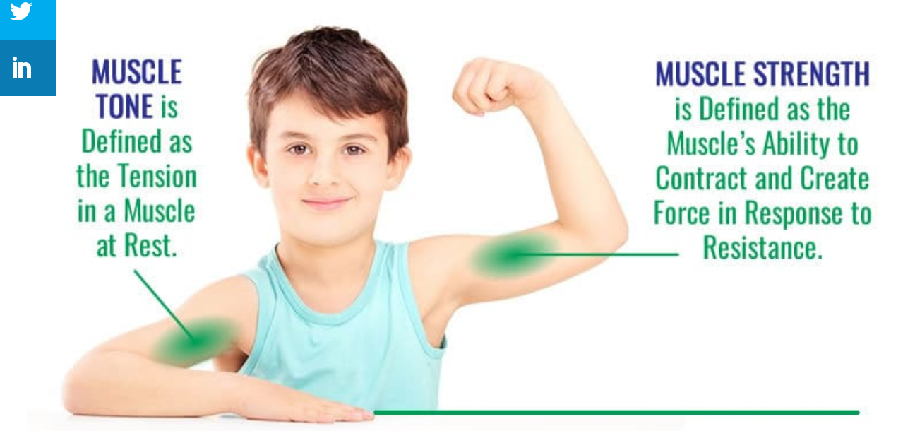
Skills Evaluation: Motor
Range of motion
Muscle strength
Muscle tone
Balance
Tremor/involuntary movement
Functional grasp patterns
Notes:
In one study, one of my students recruited people with motor impairment to assess mobile apps a11y. His 1st participant was using his right hand perfectly. He was screened because he lost some of his fingers in his left hand.
https://www.breakthroughptli.com/the-difference-between-muscle-tone-and-strength/
Ability to mobilize our muscles and bodies, and ability to manipulate objects.
Brain challenges:
Tap your right hand on the table. At the same time, make a circular movement with your left hand (as if you were cleaning the table)
Do the same, switching hands

Slide 12
Task Analysis
Identify the individual tasks the assistive technology might address
Each task is a goal (what)
Start with a high-level activity
Then decompose it hierarchically into subtasks (how)
Notes:
Example: Set alarm at 6:00am

Slide 13
Essential Parts of Task Analysis
What needs to be done?
Goal
What must be done first to make it possible
Preconditions
Tasks on which this task depends
Information that must be known to the user
What steps are involved in doing the task?
Subtasks
may be further decomposed, recursively

Slide 14
Other Questions to Ask About a Task
Where is the task performed?
What is the environment like?
noisy, dirty, dangerous, crowded
How often is the task performed?
What are its time or resource constraints?
What can go wrong?
exceptions, errors, emergencies
Who else is involved in the task?
What assistive technology (if any) is the client currently using for the task?
Notes:
Context of the task: location, time of day, cultural/institutional context

Slide 15
Hints for Better Task Analysis
Questions to ask
Why do you do this? (goal)
How do you do it? (subtasks)
Look for weaknesses in current situation
Goal failures
Wasted time
User irritation or fatigue

Slide 16
Empirical Methods to Gather Data
Contextual Inquiry
Observe client doing the tasks in their real environment
Establish a master-apprentice relationship
Client shows how and talks about it
You watch and ask questions
Challenge your own assumptions
Share your assumptions openly with client
Probe surprises
Other methods: focus groups, surveys, journaling, interviews

Slide 17
Participatory Design
Include users directly in the design team
Articulating problems and co-creating solutions in cooperation with users
Consulting users throughout the design and development iterations
And taking their input seriously into account
Taking all design decisions within the context of the users, their work and their environment
This does not mean that users are actively involved in design decisions but rather that designers remain aware of the users while making their decisions
Role of Designers
Coordinate activities
Facilitate discussion
Prepare materials
Advocate solutions
Users and designers cooperatively envision new designs, and inform each other’s perception of their practicality and utility
Mock-ups and lo-fidelity prototypes provide hands-on experience with new situations
Notes:
Can be more useful in Husen. Adam and Jan;s projects as users already using tools or apps to solve the a11y problem.
•Emerged from strong labor movement in Scandinavia in the early 70s
–political aspect, distribution of power
•From top-down, management-driven, to a bottom-up, democratic, humanistic perspective
• Articulating problems and co-creating solutions in cooperation with users
•Other names for PD include Cooperative Design and Collective Resource Approach

Slide 18
Participatory Design (PD)
Users are actively involved in development
Nothing about us without us
Should be used if you want to draw on existing artifacts
Not suited for radical design changes

Slide 19
Participatory Design (Cont.)
Data collection
Observations, interviews, collaborative design and cooperative prototyping guided by a well-defined research question
Users and designers cooperatively envision new designs, and inform each other’s perception of their practicality and utility
Data analysis
Analyze artifacts at breakdowns
Analyze videos, interviews and prototypes collected from sessions with the users
Outcome
Working with the users, the product is evolved from the existing artifact

Slide 20
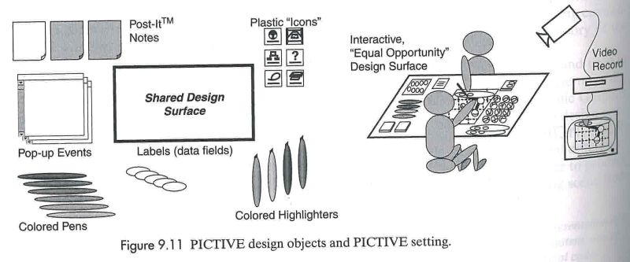
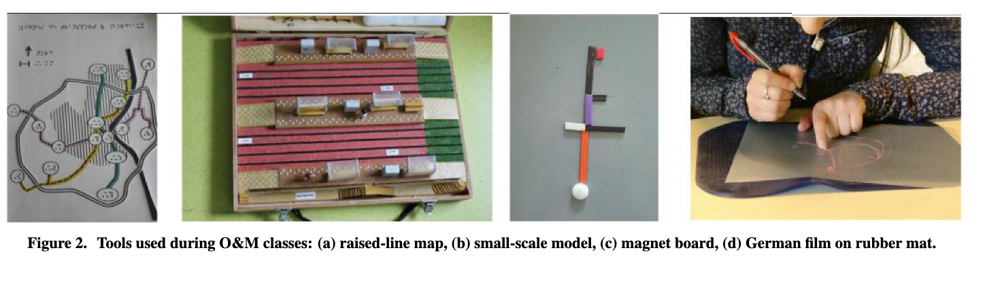
Examples of paper based prototyping techniques for PD.
Pictive
Some design components are prepared by the developers
Pen, pencil, sticky notes, paper etc. are used by the users
Video recording devices are used to record what happens
Notes:
https://dl-acm-org.ezproxy.library.wwu.edu/doi/pdf/10.1145/3173574.3174203
For blind people, you can use tangible objects, such as raised-line map, magnet board
• Mock-ups and lo-fidelity prototypes provide hands-on experience with new situations
• Everyone has the knowledge and tools (pens, scissors, etc.) to make modifications
• Everyone understands their limitations
• They can be made cheaply
• They are fun to use and modify

Slide 21
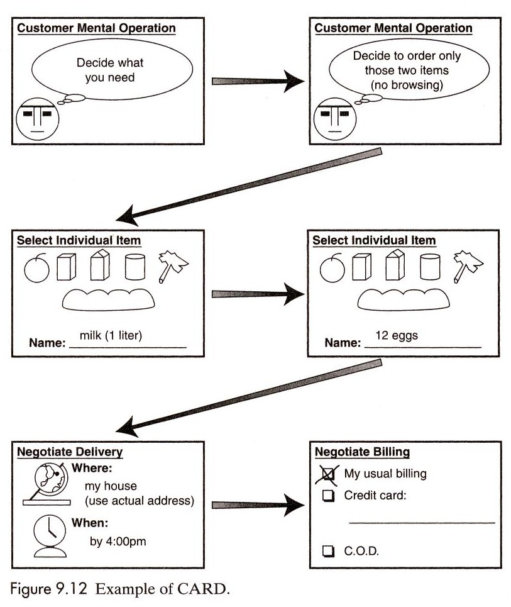
Examples of paper based prototyping techniques for PD.
Card
The same principle as Pictive but with screen dumps
The cards are used to explore workflow options with the user

Slide 22
Summary
Benefits of PD
Keeps users’ expectations in check
Drawbacks of PD
Users’ thinking can be constrained to what they are used to
Notes:
When to use: Whenever users are available and willing to take part in the design

Slide 23
3. Empirical Measurements
This means that the reactions and performance of intended users to…
printed scenarios, manuals and help, systems simulations, prototypes should be observed, measured and analyzed as early in the design and development process as possible
Choose evaluation metric(s) such as
efficiency: time on task
success rate
errors: frequency or severity
fatigue: how many times task can be done
Set quantitative and qualitative targets
“get dressed in 2 minutes”
“make coffee without assistance”
“control my bed while hand is holding something else”
Use the metrics and targets in subsequent process
evaluate on system models
predict outcome
measure on prototypes

Slide 24
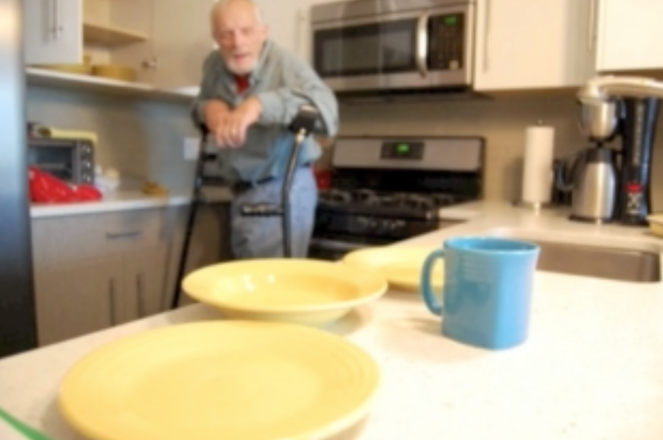
Example: User Analysis
Paul: One of my big dreams in life is to be able to carry a cup of coffee around my house
Abilities:
Right leg amputee, user of forearm crutches
Unable to hold a cup of liquid while using crutches

Slide 25
Example: Task Analysis
Goal: carry a cup of hot liquid
Key constraints: safety, no spilling, reasonable time limit, multiple times per week, no assistance
Context: at home, kitchen counter to dining room table or living room

Slide 26
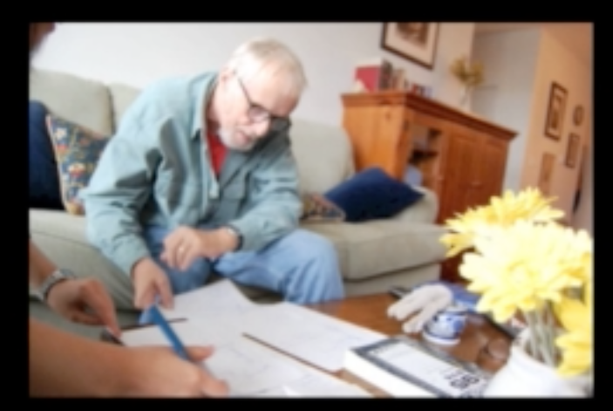
Example: Collecting Data
Interviews
Contextual inquiry
Participatory design

Slide 27
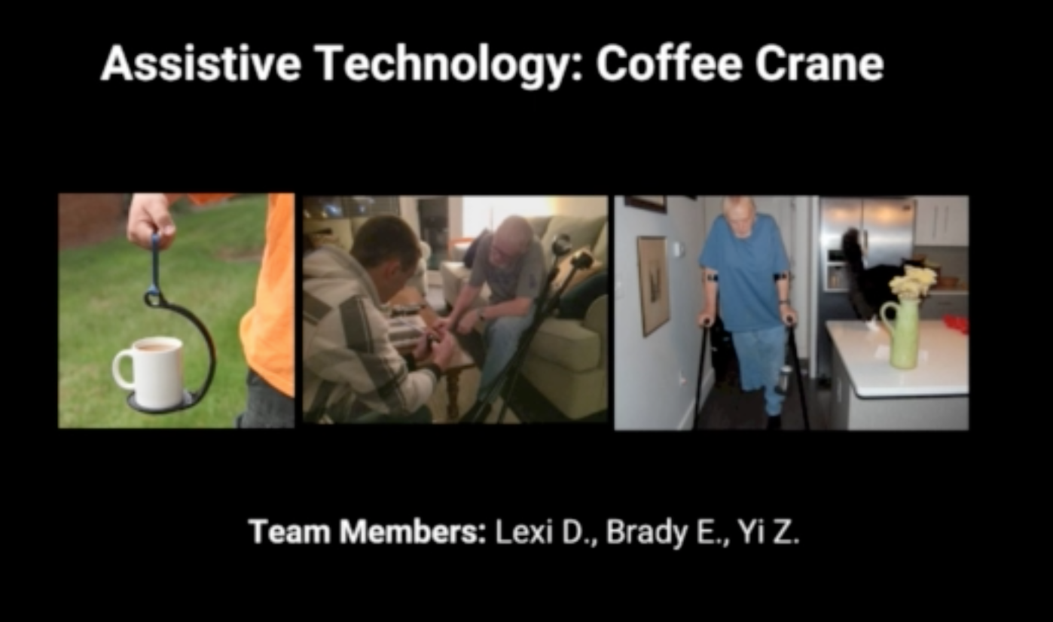
Example: Solution

Slide 28
References
Muller, M. J. Participatory design: The third space in HCI. In J. Jacko & A. Sears (Eds.), The Human-Computer Interaction Handbook. Mahwah, NJ: Lawrence Erlbaum Associates
Designing assistive technology: The human-activity-assistive technology-context (HAAT) model
Notes:
(pp. 464–481)

